Slide 1
Communications and Customer Engagement Solution
Fall 2017

Slide 2
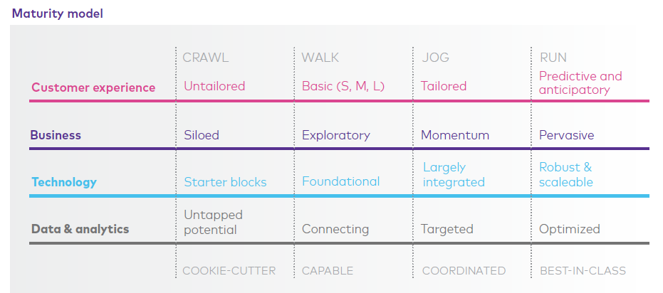
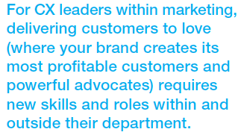
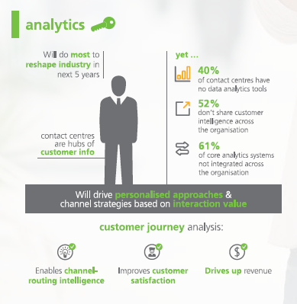
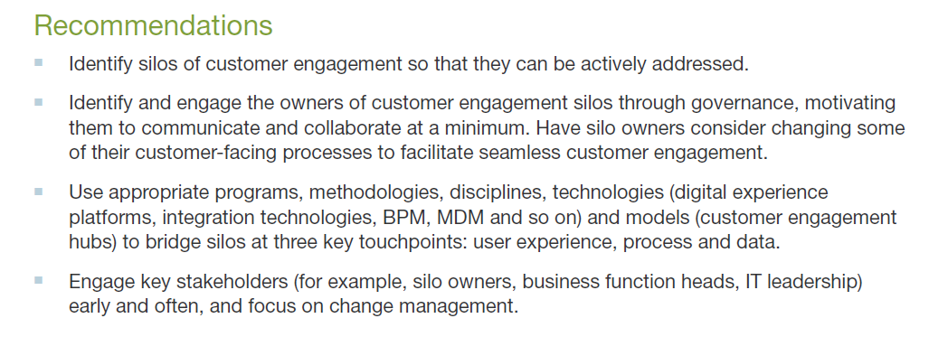
Market Research & Analysis
❸
❶
Gartner: How to Align Customer Experience
with Marketing Channel Operations
❷
Slalom Consulting: Personalization Playbook
❹
Gartner Bridge Silos of Customer Engagement, or Risk
Killing Your Customer Experience
Dimension Data: Customer Experience – Creating
powerful connections

Slide 3
Use cases transcend industries
Streamline communications
Greater personalization
Omni channel delivery
Measure customer engagement
Automate business processes
Aggregating Data
Interactive documents
Empowering customers
Governance over processes
Organizational agility
Ease of use design tools
Insurance
Banking
Telco
Utilities
Customer Comm & Engagement Challenges
Hospitality
Transportation

Slide 4
Modern Customer Engagement Is…
Ecrion Omni System
Document Production
Customer Engagement Management
Governance
Digital Experience
Customer Communications Mgmt.
Customer Intelligence
Authoring and Composition
Template Lifecycle Management
Marketing can
measure customer
engagement from
Customer interactions
Ecrion can deliver solutions
across multiple use cases
and stakeholders
Ecrion allows organizations
to implement internal
controls to ensure compliance
Our software can
empower Customer
Service teams to
resolve support
issues
System Admins
and Operations can
automate and integrate
using our flexible
platform
Notes:
Welcome to this brief explanation of Ecrion’s Omni System.
My goal is to provide you with a clear understanding of the sorts of business challenges this solution can address, and a general understanding of how our solution is applied. There are too many interlinked topics surrounding “Document Production” that are not intuitive, such as “customer communication management”, “governance” and “template management”. This solution most certainly does document production in the traditional sense, but it does so much more. These added components are not optional, but have been ushered in by the switch to digital delivery channels, and the additional weight put on engaging and timely customer communication.
We will explore modern document production during this brief introduction.

Slide 5
Why Ecrion
Ecrion differentiators:
In house development team. Technology has evolved from within vs. acquisition.
Dedicated Support and Implementation resources with deep product knowledge.
Flexible deployment scenarios (on-prem, cloud, hybrid). Cloud agnostic (AWS, Azure)
Ease of use to accelerate adoption and management.
Native integration with 3rd party LOB apps (Salesforce, DocuSign, etc.).
Affordable technology that can be deployed quickly.
Local certified solution providers to deliver and support end to end solution
Notes:
We compete with GMC Software (CCM), Open Text (ECM), PitneyBowes, Adobe.
Price points – Deal size is driven by customer requirements. In the past it was a CPU model. Our current strategy has us moving to a subscription model based on use case and deployment model.

Slide 6
Partner Opportunity
Potential revenue streams from an Ecrion engagement
Professional services revenue throughout the life cycle (design, deploy, migrate, upgrade).
Services revenue for integration (data, billing systems, 3rd party apps, etc).
Create and manage document templates.
Training (sys admin, DBA, designers, production team).
Build a vertical solution leveraging one or more Ecrion components.
Delivery of managed services leveraging Ecrion technology.
Margins for reselling licenses for both cloud and on-prem subscriptions.

Slide 7
About Ecrion
In business since 2002
Headquarters in Rockville, Maryland USA.
Development, Support, Implementation teams based in Romania
Notes:
Our platform, EOS, improves operational efficiency and increases customer lifetime value by helping companies more effectively communicate and engage with their customers.

Slide 8
Over 1000 Customers
Finance & Insurance
Government
Hospitality
Telecom
ISVs
Notes:
This is just a small subset of our customers.
Mention the global footprint.
Most Fortune 100 companies use Ecrion products. Why? Because they need to deliver relevant documents to their customer base.
Beginning this year we are focusing on larger opportunities by working at the CIO, CMO, CXO level versus developers who just need a solution to produce documents. This has yielded larger size deals that generate more license revenue and can create additional services opptys for us and our partners.
3 Core Audiences: Developers (EOS-P), Operations Mgrs (CCM), Marketing Execs (CEM)

Slide 9
Customer Communication Overview
BI
Analytics
Distribution
Enterprise Data
Business Strategy
Customer Response
Unified
Message
Production
EOS
Ecrion’s products enable dialog between a company and its customers at every stage in the communication process.
Notes:
Customer communications management (CCM) is defined by Gartner as the strategy to improve the creation, delivery, storage and retrieval of outbound communications, including those for marketing, new product introductions, renewal notifications, claims correspondence and documentation, and bill and payment notifications.
These interactions can happen through a widespread range of media and output, including documents, email, Short Message Service (SMS) and Web pages. CCM solutions support these objectives, providing companies with an application to improve outbound communications with their distributors, partners, regulatory bodies and customers.

Slide 10
Document Production
Your documents can be interactive, in multiple languages, and personalized to further connect with customers and promote loyalty, retention, and advocacy.
20+ Output formats, including HTML5
Up to 100 Million pages per day
Customer-Specific content
Batch, Interactive, and On-Demand
Archive and Search Output
Business Process & Data Integration
Notes:
Documents are the end result or output of a use case. It can be customer driven (I need a quote, invoice or report) or process driven (I need to send out an invoice or statement).
Customers come to Ecrion because they have a particular business or technology challenge and need a solution. Usually, they have an existing solution that doesn’t meet their needs, either because it is EOL, doesn’t meet performance standards, isn’t integrated with another product, needs to move to the cloud, etc. Although our software can address many processes, we typically start with one and then expand from there.

Slide 11
Enterprise Integration
Our solution is designed to fit into your existing infrastructure only where you want it.
Exposed REST API for business process integration (Inbound integration)
Invoke custom processing steps within workflows (Outbound integration)
Data Modeler for data integration (SQL, NoSQL, web services, spreadsheets, XML, CSV…)
Notes:
Most companies we work with have multiple integration points with LOB and/or back office systems including ERP, CRM, and Billing. We enable integration for business processes, workflows and data modeling. This creates services opportunities for our implementation partners.

Slide 12
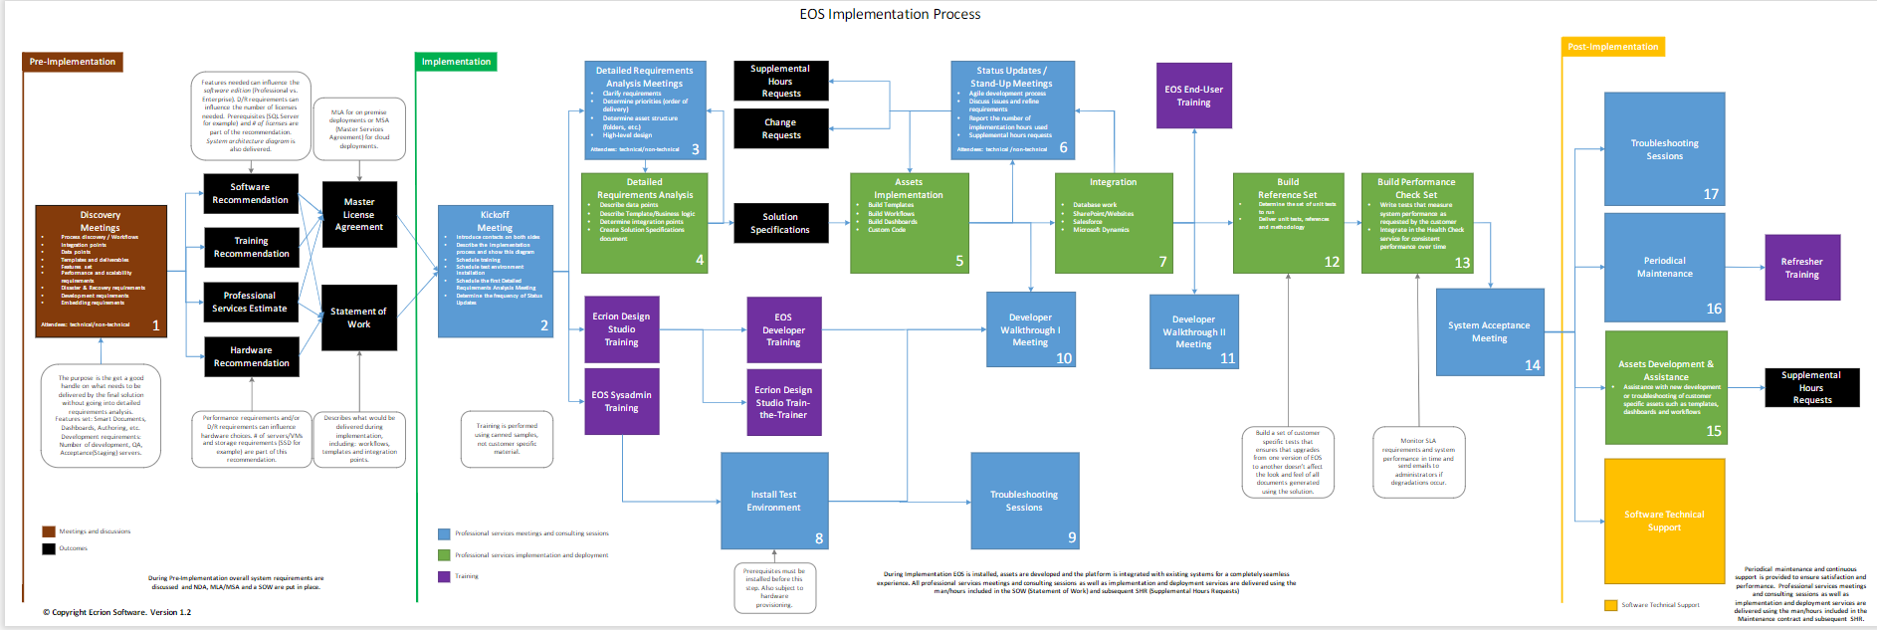
Forms Discovery thru Deployment Process
Proven best practices for form implementation projects
Discovery
Phased Migration & Roll Out
Ongoing Assistance

Slide 13
Document Delivery Goes Beyond Paper
Mail
Mobile
Electronic
Notes:
Let’s start by looking at this from your customer’s perspective. But what customer? That’s the key question. Each customer may have different delivery preferences for the exact same communication. Some will be young digital natives, and some will be retirees. To maintain customer satisfaction, and to maximize customer retention, your document production solution has to personalize delivery channels.
Let’s get more specific about delivery. Sometimes, these documents you need to produce are immediately provided to an integrated application, like a web server, so that customers visiting your web site have access to their communications. Other times, the documents are tagged and stored for later search and retrieval, perhaps with a URL to allow direct internet retrieval, or smart phone access. Most often, though, the document needs to be sent through a channel: to a print queue, an Email server, an SMS service, or even a content management system, such as Microsoft’s SharePoint.
Our solution includes outbound document delivery, and provides management and oversight of the delivery process, on a customer-by-customer basis.
The key is to be in communication with your customer on their channel of preference, with the right level of security. The EOS solution delivers this.

Slide 14
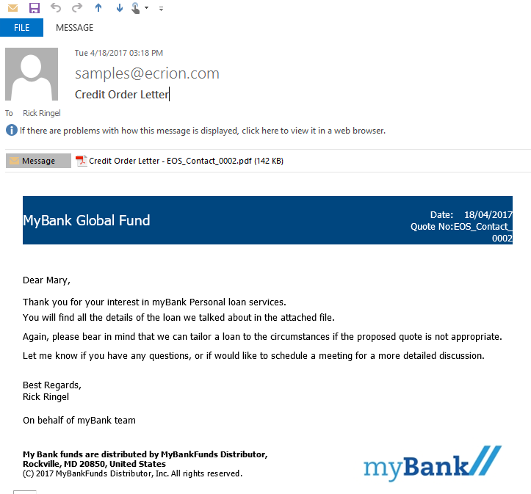
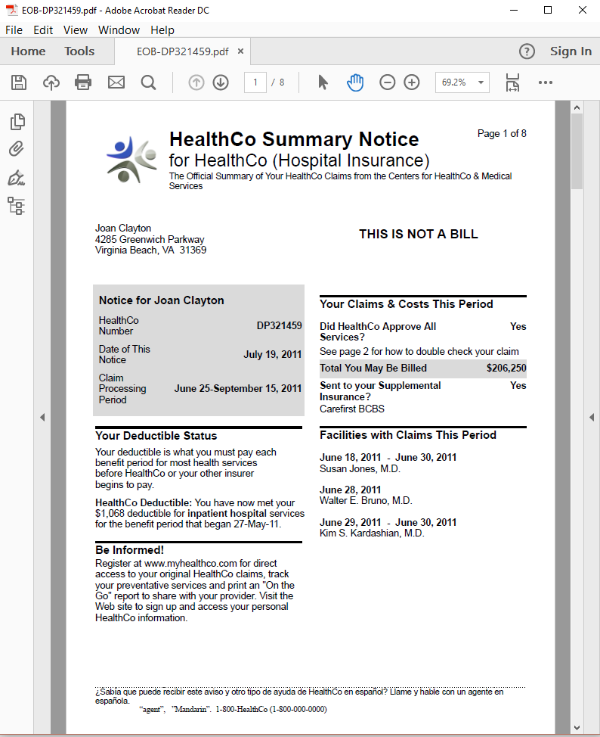
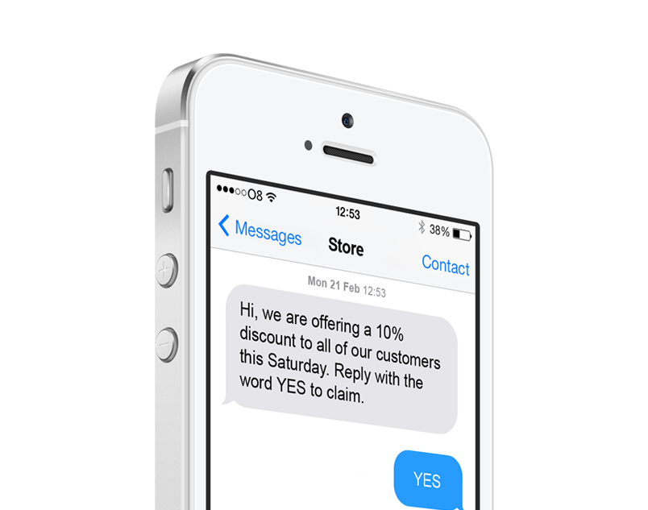
Document Production Goes Beyond Print
Notes:
The document’s format is selected according to the delivery channel. As I explained in the previous slide, customer-specific data can be used to direct delivery over the preferred channel.
Our solution produces documents in output formats specific to the selected channel, on a customer-by-customer basis. Email attachments are traditionally PDF, but Email bodies are HTML. Print streams might be AFP, but mobile phone delivery requires HTML5 and responsive documents. Modern document production requires flexibility in output formats, while supporting efficient authoring and maintenance of the document templates.
In our solution, the templates that come out of the authoring step are channel-agnostic, and it is only during composition that choices such as PDF or HTML are made. That means you only build one document template, and you can deliver it over any channel. This solution assures the right format is rendered for the selected channel.
The importance of this cannot be overlooked. Previous investments you have made in authoring documents can be leveraged to support new delivery channels, incrementally, according to your business needs. Subdocuments, which are reusable components, can be reused across channels. This improves ROI by lowering your maintenance and development costs, and it helps you govern the process by keeping redundancy out of your template library.

Slide 15
What Was Document Production Is Now Customer Communication Management
Flexible
Agile
Governed
Coupled with Business Process
But through Delegation
Notes:
When we consider that customer preferences, different channels, and different content all have to come together, then our traditional definition of document production isn’t satisfactory any more.
These complexities need to be addressed, just as the EOS solution has done.
Flexibility is necessary in order to support innovative customer-centric business strategies. Channel preference is just the beginning. Dynamic content and targeted messaging are also new requirements that fall into the “flexibility” category.
Agility is necessary in order to eliminate customer communication project backlogs. Agility means your inspiration for a new document or an updated document can become a reality with no delays. It means automation within the design and test processes, as well as automation within the production processes.
Governance is necessary in order to keep order, assure quality, and secure personal information. A company’s brand has never been more exposed, as the number of documents and the number of changes to these documents is increasing as customer-centric strategies take root. Governance assures that stakeholders participate through policy and key interactions, without dragging these busy people into day-to-day operations.
Customer Communications Management is the new document production.
Document production has always been coupled with business process, but the nature of that relationship has changed. Business processes deal with services, finances, tracking, shipping, billing, and the like. But, with the EOS solution, those automated business processes no longer embed any document production logic. Instead, document production is delegated, and the EOS solution, the manager of your customer communications, deal with all the variations that serve your customer base. Targeting and personalization, document content and brand policy, all are now centralized in the CCM layer, which free your automated business processes from constant change as the flexibility and agility are put to work.

Slide 16
Document Authoring & Document Composition
Two Phases, One Unified Movement
Authoring – Document Design and Layout
Encourage Template Reuse
Orchestrate Digital Asset Assembly
Achieve Customer-by-Customer Variation
Engage with Customer
Efficiently Design Across Team
Composition – Data gathering, Rendering and Delivery
Automate and Integrate
Attain High Capacity and Low Latency
Remain Scalable
Oversee and Administer
Store, Search, and Deliver
Remain Flexible
Notes:
The EOS solution provides the authoring environment, and it provides the composition environment. But with this solution, the two flow together seamlessly. At the center of this is the digital asset repository. The Authoring step places images, templates, business rules, and other supporting files into the repository, while the Composition step draws from the repository. Governance features oversee the progression of digital assets from the author’s initial draft all the way into the secured production environment. Two phases, but one graceful flow.
(Talk through the bullet items, underscoring value, rather than features, according to interest level of audience. Careful not to get bogged down in detail)
Authoring
Template reused means lower costs and less time (agility).
Digital Asset assembly means governance over things like images, styles, headers, footers, brand, all within assets shared across multiple document projects. (agility)
One template with variation (flexibility) is more cost effective, and easy to incrementally improve (agility)
Engaging content, like interactive documents and targeted content improve customer satisfaction.
Teamwork is essential to end backlogs – specific tools for specific skill sets, working in concert in a shared workspace.
Composition
Integrate with your data sources, integrate with your business processes. Reduce risk of manual steps, improve efficiency through automation, and isolate customer communication management from your business processes.
Never be bottlenecked – solution supports high capacity batch, and low-latency on-demand,
Capacity increases are simple hardware additions (load balancing over servers)
Oversee through previews, job history, advanced search, dashboards, audit trails, version history, etc.
Provide universal access. Solution stores all documents for later retrieval through APIs, URLs, GUIS, search, etc. Also delivers documents to printers, Email servers, content management services, etc. Reach your customers on the channels they prefer.
One customer communication infrastructure to serve periodic, on-demand, and correspondence needs.

Slide 17
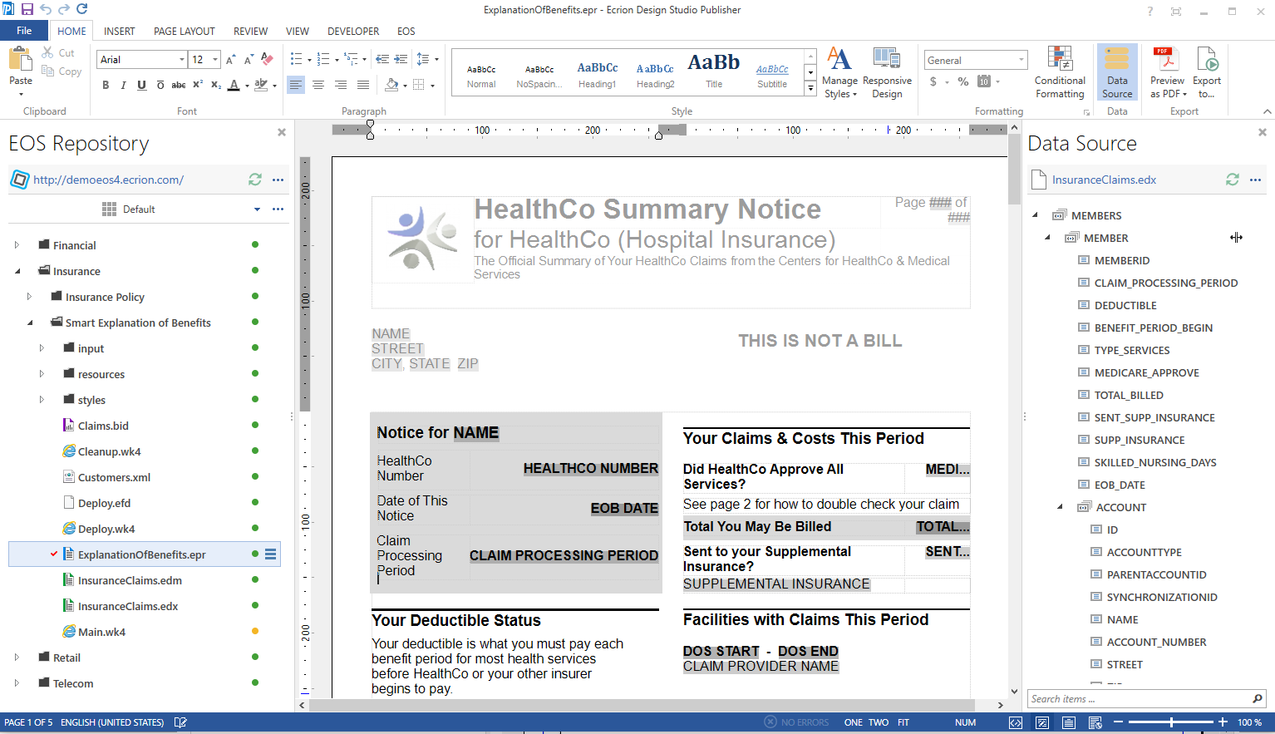
Document Authoring: Templates
Ecrion Design Studio: Publisher
Easy to Use
WSIWIG
Design Surface
EOS
Integration
Drag & Drop Dynamic Data
Notes:
Solution Specifics – Tool benefits for Publisher
Just talk through, being only as detailed as audience needs.
Key Values:
Easy for business users to use this
Easy access to data fields
Governance and teamwork through integrated connection with document repository

Slide 18
Document Authoring: Templates
Ecrion Design Studio: Data Modeler
Graphic Extract- Transform- Load
Uniform Data Output
EOS
Integration
Diverse Data Sources and Formats
Filter, Join, Normalize
Notes:
More document authoring tools
Data Modeler
Key Values:
Maximize teamwork: Let your IT people own the data access, and put document layout and content on business users
Agility & Reuse: Data models can be reused in multiple projects
Remain flexible! Absorb changes in storage architecture without impacting templates

Slide 19
Document Authoring: Templates
Ecrion Design Studio: Architect
Data Visualization Toolbox
Uniform Data Input
EOS
Integration
Maps, Charts, Tables, etc.
Embedded Data Operations
Notes:
Another authoring tool
Main Values:
- Engage with Advanced data visualization and even interactive graphs and charts
Teamwork again: data visualization expert provides drag-and-drop widgets to team doing layout of documents.
Reuse across projects
Data is prepared by Data Model, with all those benefits passing to data visualization tool too.

Slide 20
Summary: Ecrion Design Studio’s Benefits
Ease of Use
Extend Team of Collaborators
Skill-Specific Tools
Empower Specialists to Contribute
Integrated Collaboration Workspace
Empower Teamwork
Enterprise Data Model
Retain flexibility
Interactive Documents
Engage with Customers
Channel Agnostic Templates & Assets
One Template serves all channels
EDS Authoring Solution
Notes:
Summarize from previous steps, again underscoring value.
This is more of a feature->value map.
The solution delivers [] and your benefit is []

Slide 21
Document Composition: Integration
Notes:
After a template has been authored, it then has to be integrated into your business process. This is a critical part of the solution.
The composition step should be isolated from the higher-level business processes. They should never need to deal with communication details, such as delivery channel. On the other hand, the higher-level business process is in charge, and needs to delegate document production in a variety of different situations, with a variety of different triggers.
The EOS server sits between your business processes, databases and applications, and the output of our authoring tools. On the business side, the server integrates with your business process in real time through different types of triggers, APIs and data acquisition protocols and products. On the authoring side, it pulls in all the templates, digital assets, and data necessary to render the perfect document to support the business situation.
This is all orchestrated, one production process, gracefully executed from end to end.
The EOS solution excels at this integration, both in terms of data integration, and in terms of process integration. Web site pages are built using an On-Demand interface that returns documents immediately to the client. Periodic documents run in batch, with capacity to produce millions of documents in a day. Correspondence is built interactively, validating input and placing a layer of control over content and layout of standard and ad-hoc communications.

Slide 22
Document Composition: Workflows
Connects to Business Process
Document Production Rules Independent
Connects to Collaboration Projects
No external digital asset management
Ease of Use
Programmers Unnecessary
Conditional Paths for Each Customer
Personalize, execute preferences
Omni-Channel Distribution
Print, Email, SMS, Web, etc.
Notes:
Workflows orchestrate the production of every document.
Flexibility is achieved through these workflows
Many different ways to trigger execution
Many different ways to get data into the workflow
Data-driven paths through the workflow
The key value is in the ease of use, and the flexibility it provides.
Add new paths incrementally
Use customer preferences to drive workflow steps
Deliver documents and document content back into business process (especially correspondence)

Slide 23
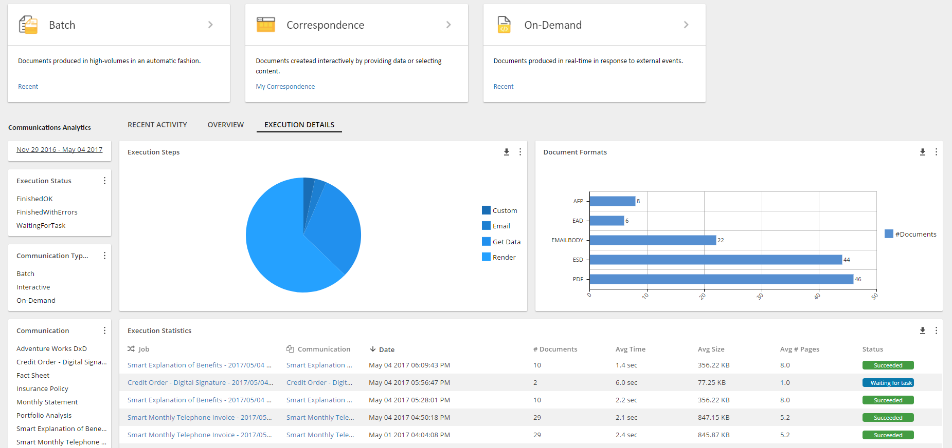
Document Composition: Administration
Production Automation
Event triggers, time triggers, etc.
Dashboards
Investigate Operational Status
Production History
Support Audits, Search
Security Management
Personal Info, Production Environment
Environment Configuration
Isolate Develop, Test, Production, etc.
Notes:
So far we have talked about the authoring and composition aspects of our product. But, in addition, all of this needs to be managed.
Management as a topic can take quite some time to walk through, so I won’t hit you with much detail. I will mention though, that this is one of our favorite topics on our blog, and I encourage you to take a look.
Automation is set up through the admin interface. GUIs offer configuration options for triggers, public URLs, schedules.
Dashboards offer visual representation of the health of the system, and the server’s progress and throughput.
Sometimes audit is essential, especially when a third party is investigating conformance. Audit trails are built into the EOS solution, along with advanced search features.
Security management is essential. We can never lose site of the personal nature of much of the data that goes into these document composition processes. Our solution offers security frameworks that support your policies, be it a central identity management system, or encryption of data.
Keep staff partitioned according to their role – developers not able to see production system files, and strict policy enforcement when moving projects from one environment to another.

Slide 24
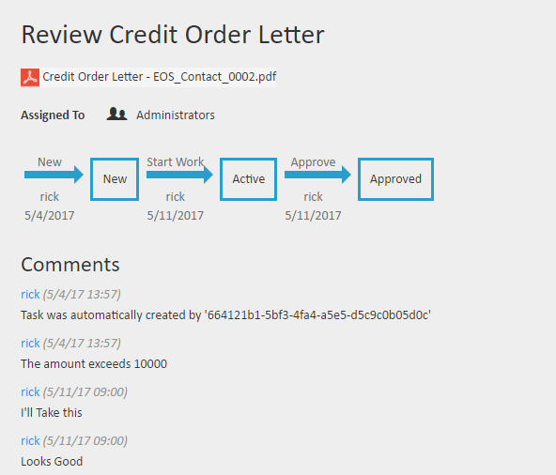
Document Composition: Governance
Review Outbound Docs Before Delivery
Assure Quality, Accountability
Review As Projects Proceed to Production
Support Stakeholder Participation
Shared Digital Assets
Manage Branding
Security Management
Limit Access to Workspaces, Documents
Repository Version Control
Track changes, roll back option
Metadata and Advanced Search
Find Every asset and rendered document
Notes:
Governance is about two things: assuring policy is enforced, and about giving stakeholders accountability over the policies they are interested in.
Review and Approval is part of the workflow’s orchestration process.
Conditions based on business rules can trigger a review prior to delivery (e.g. customer service rep is still in training).
Invite stakeholders to review and approve project and project output prior to promoting into the production environment. Accountability and approval history is captured and available.
Distribute digital asset responsibilities: branding to marketing (style sheets, images, etc), terms and conditions to legal, messaging to sales.
Use permissions to assure limited access appropriate to each team member.
Know what has changed and why, and always be able to role changes back out.
Never spend time looking for a document or an asset – use search rather than try to navigate through multiple levels of file structures (like Google and the Internet)
Project test methodologies, as well as version control, and a built-in review and approval framework, provide a managed path from development all the way to your production systems.
It includes composition-time choices of which templates to use for a given business process. All of this taken together constitutes “template lifecycle management”, and is built into our solution.
Management also means that stakeholders, who are not part of the day-to-day operations of the system, have controls in place that assure their policies are followed. Is the right logo used on every document? Is the standard contact information consistent and up to date? Our solution offers these sorts of controls. The general term we use for this is governance.

Slide 25
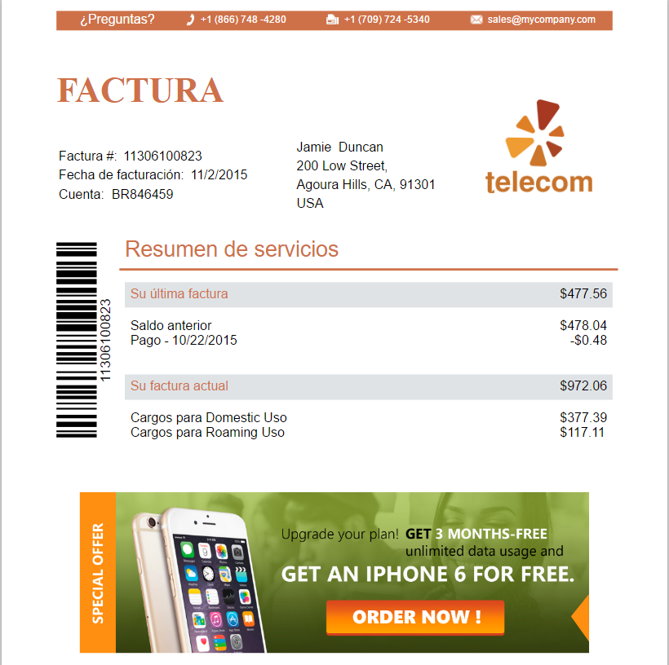
Document Composition: Personalization
Target Content to Customer Segments
Improve engagement, satisfaction, loyalty
Integrated Preference Management
Flexible, Easy Expansion of preferences
Customer self-administration
Save time and money
Overlay Messaging
Add/change messages without risk
Notes:
During composition, dynamic data is not only placed into the document, but it can also drive conditional content.
Let’s say you have two different marketing images, one for prime customers, and another for lower priority customers. Our solution makes it easy to use a single template to render this one way or another, according to the customer’s profile. That is just one example of how to use our tool to –target- customers without the burden of authoring countless templates.
Targeting is not quite customer-specific, though. Targeting is based on segmentation of your customers. The solution also provides for personalization. This may be as broad as selecting languages as is shown here in the slide, or as specific as customizing the look of a monthly invoice to include either tables or pie charts, according to their preference.
Customer preference management is built into our solution. Offer self-administration to save money, and keep all preferences isolated within the solution to remain flexible and agile. Avoid programming preference fields into other applications that don’t even use them.
Overlay messaging on top of tested production documents. Manage messages to specific customer segments, and get metrics showing engagement. Build up your ability to engage through this feedback.
The overall goal here is to maximize the value of the customer experience. Our solution provides the tools necessary to accomplish this on a customer-by-customer basis.

Slide 26
Document Production at Scale
Personalized communications and delivery
Error free correspondence management
Measuring engagement and customer journey

Slide 27
Document production at scale
Companies rely on Ecrion to deliver millions of documents/day in a error-free manner to millions of customers around the globe
Documents (letters, invoices, generic correspondence) are generated dynamically from data
Language and formatting is applied using a combination of preferences and account information
Solution can scale both horizontally (more computers) or vertically (better hardware) to accommodate any volumes for further growth and expansion of business
Documents can be produced in parallel for multiple delivery channels including print, email, SMS, social media, and more.
Document production at scale also includes complexity. The software can produce complicated letters, brochures, product catalogs with TOC, index, footnotes, images, and charts.
Archiving in common formats (PDF/A)
Superb print capabilities including full color support, PDF/X output, AFP printing and ICC color profiles
Scalable document production helps you deliver higher frequency, more reliable output to customers, strengthening the relationship your customers have with your company.

Slide 28
Document production at scale by role
 | Developer Lead | Imp | Marketing Lead | Imp | Operations Lead | Imp | CFO | Imp | CEO | Imp
Deliver Millions of Documents | I need a tool that can support high volumes. | 1 | I need to send marketing messages to our customers when I want to (according to strategy) | 2 | I worry that I can’t support high volume send without errors. I also worry that I will have to run small batches, multiple times bec. solution is unreliable | 1 | I care about getting invoices out on time, correctly, to the right people, the first time. I want us to get paid. I worry that we can’t scale to support the upcoming growth (& automate the dunning process). | 1 | I plan to grow the business and need to be sure all solutions scale with future growth plans. | 1
Error-free Delivery | Of course, that’s my job | 1 | Measuring engagement must rely on error free delivery | 2 | Errors cost time and money. But must also be able to detect/correct errors. It’s never 100% error free | 1 | I rely on Ops Lead to send invoices. I care about a reduced time to collect payments | 2 | I rely on my teams to send comms to customers error-free. Compliance with regulations is important to me and it relies on sending comms/invoices with no errors | 2
Dynamic Document Generation from Data | I have a lot of data points that I need to present | 1 | If someone’s status changes (married, birth, died), I need to be able to communicate to them/update comms | 1 | I don’t want to do any manual data pulls, I want to program what data sources are used (or combine all of them) to send comms | 2 | When changes are made to an account, I want to track that revenue and make sure we are paid on it/invoices are generated appropriately | 2 | Premium customers deserve more than regular customers. The premium customer plan was my idea and I want to make sure it succeeds and we get paid | 2
Multi-language output | I need to use date formats and language according to location/preference of customer | 1 | I want to meet customers where they live (language, geo location, etc.) | 2 | This is a pain in the neck. I need a system that reliably selects the language. [note: Ceridien as an example] | 1 | Opens up new markets if we can bill in diff languages | 3 | I want to make sure I can support global expansion. Compliance – some regulations require multi-lang | 1
Delivery format according to customer pref | I need to produce traditional formats like PDF and print, and new formats like HTML 5 | 2 | I want to make customers happy so they stick around. If that means sending to mobile or print I’m in. | 2 | I have a requirement to send docs according to customer pref. Could be a cost saver for me, because sending digitally saves on postage and printing | 2 | Cost savings to send invoices digitally. Happy customers spend money so let’s make them happy to receive our invoices | 3 | Reach new marketing/generationally Customized delivery format is huge because I can target markets efficiently and attract newcomers by leveraging new channels | 2
IMP = Importance. 1= high (have to have), 2= mid (nice to have), 3= low (not a priority)

Slide 29
Document production at scale by role (cont.)
 | Developer Lead | Imp | Marketing Lead | Imp | Operations Lead | Imp | CFO | Imp | CEO | Imp
Omni-channel output of document formats | I need a tool that can support high output and multi-format at the same time | 2 | I need Dev to be able to send these key marketing messages in multiple formats. Generational marketing means some prefer digital or print. Plus I need to report on engagement per channel. | 2 | Simplification of Omni-channel delivery. I need a system where one click sends to smart phones, social media, email, print, etc. | 2 | Omni-channel support allows me to cut down on headcount. The business doesn’t needs one person to do emails and one person to do print when the system can do both. | 1 | Meeting customers through multi channels helps increase sales activity. Customers are more likely to read our message when we send it however they are used to reading things. | 2
Complexity | Data is complicated sometimes and I need to be able to use it | 1 | Consistent branding throughout complex docs | 1 | When compounded with volume this is bothersome. With an old solution sometimes I have to cut back on complexity because the system can’t take it. That wastes time. | 2 | What do our internal financials look like, and can I use this tool? Do invoices and contracts have consistency and are they accurate to each customer. Complex statements show value to our customers. | 2 | Our annual report is complex. I don’t care how you do it, just make it right. I want to grow into more and more complex markets, so we need to be sure complexity is possible. Complex statements show value to our customers – and build loyalty. | 1
Archiving to common formats and 508 compliance | Archiving must be compliant with PDF/A and other standards | 2 | Customers want to access older statements, let’s make that easy | 3 | Archiving must be compliant with PDF/A and other standards 508 compliance | 1 | Compliance with new regulations means no fines. | 1 | Compliance with new regulations shows leadership in the market | 2
Superb print capabilities | Support print formats and use high volume printers | 2 | Quality of graphics and print. | 1 | Leverage the big printer we bought – use existing expensive equipment | 1 | We spent a lot on that printer… infrastructure investment. CFO is happy if it’s not being wasted. Deliquent recoup of funds and other official documents may require printing vs. Digital delivery. | 2 | Face of the company. How things look reflects our success. | 1

Slide 30
Personalized communications and delivery
Each communication (document, email, etc.) looks like it’s been specifically prepared for a customer
Includes personalized salutation, language, account manager, colors
Advertising is also personalized
Customer preferences dictate how the document is delivered (email, sms, print, or both) and the format (short, long, black and white, with interactive charts, etc.)
Customer account information also drives personalization (premium customers can have have different looking statements than other customers).
Generational targeting for your current customer base and future customers
Personalization strengthens the relationship with your company – customers feel appreciated and in return will give more business

Slide 31
Personalized communications and delivery by role
 | Developer Lead | Imp | Marketing Lead | Imp | Operations Lead | Imp | CFO | Imp | CEO | Imp
Each piece in a batch is unique/personalized to each recipient | Has to be data driven. I don’t want to do this one at a time. | 2 | Customers feel special when they receive unexpectedly personalized communications from us | 2 | I want to make sure I’m able to generate individual docs based on data in high volume | 2 | Account-related docs have the correct recip. Error free operations tie in here, because invoices that are sent incorrectly could mean delays in payment. | 1 | Strengthen relationship with our customer. Shows we remember our roots and believe in our customers | 2
No errors in personalization/recipient match | Insert validation to make sure accurate output is important. Flag invalid data records. | 1 | Mistakes make us look stupid. | 2 | I want to be able to report on invalid data, exclude those from the batch – come back later and fix the data. | 1 | Mistakes cost us money. Invoicing the wrong person or wrong amount could cause a delay in payment. | 1 | Mistakes make us look bad. | 2
Advertising within comms that’s personalized to the recipient | I want to give marketing a way to introduce ads without me having to do it every time | 3 | I want to control our advertising efforts, including placing banner or text ads in outbound comms (like invoices) in accordance with transaction data or demographic data variables | 1 | I don’t want the marketing message to mess up my statements – so I need some kind of oversight. | 3 | Sometimes advertising can be a source of revenue unless it disguises the billing aspect of customer documents. But free is always good – so if this doesn’t cost extra I could be onboard. | 3 | Smart advertising can increase revenue and generate more leads. It’s a smart greenfield strategy. | 2
Delivery format according to customer preference | I need to produce traditional formats like PDF and print, and new formats like HTML 5 | 2 | I want to make customers happy so they stick around. If that means sending to mobile or print I’m in. | 2 | I have a requirement to send docs according to customer pref. Could be a cost saver for me, because sending digitally saves on postage and printing | 2 | Cost savings to send invoices digitally. Happy customers spend money so let’s make them happy to receive our invoices | 3 | Reach new marketing/generationally Customized delivery format is huge because I can target markets efficiently and attract newcomers by leveraging new channels | 2
IMP = Importance. 1= high (have to have), 2= mid (nice to have), 3= low (not a priority)

Slide 32
Personalized communications and delivery by role
 | Developer Lead | Imp | Marketing Lead | Imp | Operations Lead | Imp | CFO | Imp | CEO | Imp
Customer preference drives personalization to some extent | I need to produce traditional formats like PDF and print, and new formats like HTML 5 | 2 | I want to make customers happy so they stick around. If that means sending to mobile or print I’m in. | 2 | I have a requirement to send docs according to customer pref. Could be a cost saver for me, because sending digitally saves on postage and printing | 2 | Cost savings to send invoices digitally. Happy customers spend money so let’s make them happy to receive our invoices | 3 | Reach new marketing/generationally Customized delivery format is huge because I can target markets efficiently and attract newcomers by leveraging new channels | 2
Customer account info drives personalization to some extent | I must have the ability to pull data from multiple sources and I have a lot of data points that I need to present | 2 | If someone’s personal status changes (married, new boat, new baby), I need to be able to communicate to them appropriately. If services or people are added to/removed from the account, I need a solution that will recognize the new data and adjust comms automatically. | 1 | We have a LOT of data sources. I need a system that draws on all of them. Customer preference, account information, demographics, etc. Otherwise, I have to find a data aggregator too. | 1 | When invoices are accurate, billing is easier. Account changes happen a lot so we need our system to recognize when new services are added or expire. | 1 | I rely on my CFO and Operations lead to send accurate communications – based on who owns which of our products and how complex their accounts are. I expect this to be done well and on-time. | 2
Generational targeting | I need to generate and distribute different formats according to demographic or other data | 2 | Different generations respond to different formats, so we need to be able to send print to one kind of user and digital to another. | 2 | I wat to target marketing efforts based on age as well as other variables | 3 | Whatever gets us paid. If we need to send a mix of print and digital, just get it done. Digital saves money, so do more of that. | 3 | More opportunities with the upcoming generations. As boomers age out of the workforce/spending groups, more and more younger people will be taking their places. | 3
IMP = Importance. 1= high (have to have), 2= mid (nice to have), 3= low (not a priority)

Slide 33
Error free correspondence management
Ease to produce correspondence by simply filling out a form
In-place validation ensure correspondence is filled out properly before moving to the next step in the workflow
Fully customizable review and approval capabilities include support for approval chain for traceable accountability
Scale better with support for globally distributed approval teams while being able to approve correspondence in advance with a future effective date
Ad-hoc correspondence is also supported and can be created with a few clicks of the mouse
Digital signatures eliminates paper and speeds up processes and eliminate error
Can be incorporated in manual and batch (automatic) processes
Correspondence is centered around the customer. Front end teams get a 360 degree view of the inbound and outbound correspondence right from the customer profile.

Slide 34
Error free correspondence management by role
 | Developer Lead | Imp | Marketing Lead | Imp | Operations Lead | Imp | CFO | Imp | CEO | Imp
Easy to produce correspondence by filling in a form | I can concentrate on getting the data and processing the data instead of building the form. | 1 | I can build the form easily without dev support. Correspondence is customized by whatever form fields I choose. | 1 | I have to manage 100s and 1000s of forms. It’s important to have a system in place that can do that effectively. I like knowing that Dev won’t be tied up helping Marketing or Ops with this. | 1 | Simplification and interdepartmental customization-ability cuts on costs and resources. Giving the front-end access to these forms prevents duplication. Increase productivity/streamline because we don’t have to have so many meetings about this – marketing/ops can just handle it. | 2 | Operational efficiency! Increase productivity/streamline because we don’t have to have so many meetings about this – marketing/ops can just handle it. Gives me value prop drill-down if I want it. | 2
Validation to ensure correspondence is accurate | I like this because I need to be able to program complex logic based on the data and stop invalid data from getting into my database | 2 | Mistakes make us look stupid. | 2 | Strong validation is a must if you want to be able to process 1000s of forms. | 1 | Checks and balances ensure compliance and regulations are met and maintained. Error free contracts and billing are key. | 1 | Error free contracts and billing are key. Compliance is met. Validation reduces back-and-forth costs. Automating this eliminates human error. | 1
Fully customizable review & approval | I need to be able to let business people participate in the approval process | 2 | I want to see what we’re sending out before it goes out. | 2 | I can set up approval/review based on role. I want to have control before the data comes into the system. | 2 | Reduce risk by reviewing and approving correspondence before it goes to the customer. Cuts down on critical errors and provides a chance to make more $$ -- in the review process you can review the customer input as well as the company output. Build triggers and alerts into a contract, for example. | 1 | Approval can be conditional, meaning that I only see the most strategic correspondence. Reduce risk by reviewing and approving correspondence before it goes to the customer. | 2
IMP = Importance. 1= high (have to have), 2= mid (nice to have), 3= low (not a priority)

Slide 35
Error free correspondence management by role (cont.)
 | Developer Lead | Imp | Marketing Lead | Imp | Operations Lead | Imp | CFO | Imp | CEO | Imp
Distributed approval teams | Business people can customize the approval process as they see fit | 3 | My boss sees what he needs to but I can handle smaller things. Fosters collaboration by role-based approval chain. | 2 | Flexibility and collaboration between teams. Collaborate regardless of geo distribution, and I can intervene if process gets ”stuck”. | 1 | This allows for automatic interdepartmental collaboration. Can have legal, finance, implementation pass approval on the same doc in a specific timeframe. | 2 | Approval can be conditional, meaning that I only see the most strategic correspondence. This allows for interdepartmental collaboration. Can have legal, finance, implementation pass approval on the same doc in a specific timeframe. Automation reduces human error. | 2
Review/ approve correspondence for a future effective date | I need to be able to accommodate future business requirements | 2 | This allows me to work ahead when branding changes, etc. | 2 | I don’t want to be here on a holiday making sure the forms are ready to go on Jan 1. Working ahead cuts down on errors. | 1 | Can change docs based on year and have it be effective on Jan 1, for example. Ensures compliance and accuracy. Set up monthly invoices in advance at the start of the deal, approve them to be live when appropriate | 2 | Ensures compliance and accuracy. Allows for more scalability – smaller team can work in advance. | 2
Ad-hoc correspondence creation | Sometimes I have no control – have to give ultimate flexibility to the business so they can type whatever they want | 3 | This is the best way to cater to specific customers, creating one-off messaging. Also lets me tell customers when something is special – limited time, changing market conditions, etc. | 1 | This is the last line of defense. If I need to send something manual I must have this capability | 1 | I like having the ability to use this system and send unforeseen legal and financial docs/cease and desist, final notice, etc. Responding to market conditions – recalls, PR nightmares, etc. | 2 | I can get my ideas executed to market quickly and without drama. | 3 (this should be happening anyway)
IMP = Importance. 1= high (have to have), 2= mid (nice to have), 3= low (not a priority)

Slide 36
Error free correspondence management by role (cont. 2)
 | Developer Lead | Imp | Marketing Lead | Imp | Operations Lead | Imp | CFO | Imp | CEO | Imp
Digital signatures | I need to make everything digital and not use the printing press if possible. | 1 | Documents return more quickly and that makes CEO happy | 3 | I need to create a solid process with no gaps – I can use whatever digital signature provider we are working with. This is a well-established practice in business and I want to take advantage of that. Cuts down on costs. Integrates with the approval chain so I can collect as many sigs as needed. | 1 | Modernizes the business process – no scan/fax needed when e-sig is employed. Cuts down on costs and gets completed contracts in the door faster so we can bill sooner. | 2 | Cuts down on costs if we do this digitally. Helps with compliance, and gets completed contracts in the door faster. | 2
Front-end teams get 360 view of inbound and outbound correspondence and historical data | Allows historical data pulls if necessary | 2 | I like that my team can see the same history and data as I can—so I can delegate forensic researching if needed | 2 | My teams need to be able to find info quickly and to tell the customers the status of their request if needed. | 1 | -- | 3 | The people manning the phones are the public representatives of my company. I want them to be able to access all available data to solve customer issues and make customers happy. Happy customers buy more product! | 1
Decision makers can also have a 360 view of inbound and outbound correspondence and historical data | -- | 3 | Can’t have effective comms without a full view of the customer and how we’ve communicated with them in the past. I can trigger events/touchpoints based on historical data. | 1 | I can run ad-hoc reports that tell me how many contracts are pending vs. approved | 2 | Aggregate view vs. individual view of the customer – aggregate views show me how many of something (contracts) are completed vs. pending. Individual views show me who (which contracts) are pending. | 2 | I need to be able to make decisions based on all the available data/trends as well as historical data. I need to be able to drill down to the individual level as needed. | 1
IMP = Importance. 1= high (have to have), 2= mid (nice to have), 3= low (not a priority)

Slide 37
Measuring engagement and customer journey
At-a-glance visibility on all interactions that your customers are having with your company with full drill-down and report capabilities
Determine which touchpoints resonate with customers and where there is room for improvement
Automate interactions with workflows associated with each touchpoint on the customer journey
Launch corrective actions to keep customer on their ideal journey whenever deviations occur
Workflows can initiate not only on-stage interactions with the prospect/customer but also internal tasks to your team
Extract tangible, measurable ROI by moving customers faster through the customer journey towards making a purchase or achieving a set goal

Slide 38
Measuring engagement and customer journey by role
 | Developer Lead | Imp | Marketing Lead | Imp | Operations Lead | Imp | CFO | Imp | CEO | Imp
Visibility into customer interaction on a whole | Additional data points I can use to customize comms/build reports. | 2 | This gives me an overview of where customers are in each stage of the journey and helps me focus my marketing efforts where people are getting stuck. | 1 | This can help me pinpoint problems in my processes and scalability issues and needs. | 2 | I can tell where people are getting stuck on the customer journey/how long it takes them to make it through the journey. I can see churn and gold members and predict what will happen in future. Helps me plan revenue. 30/60/90 day outlook. | 2 | Helps CFO plan revenue. 30/60/90 day outlook. Gives me an idea of many new customers we will be getting at a given time – so I can allocate resources & plan for scale. Ties in to “Automate customer interaction based on touchpoints” | 2
Drill-down & reporting on customer interaction | Additional data points I can use to customize comms/build reports. | 2 | Helps me identify problems while they are small enough to fix, helps me identify star content/paths and helps me focus my team on the right efforts – can use other functionality for personalized touches and approvals | 1 | Reporting functionality helps me talk to the CFO and CEO. | 3 | This is really for marketing. They will let me know if this impacts revenue | 3 | I can spot-check individuals with the appropriate internal teams/or by myself. | 2
Determine which touchpoints resonate with customers | Additional data point that helps me learn more about this process – also helps me prepare for future conversations with exec team | 3 | This is key. I need to know what works and what doesn't’t so I can focus my efforts/team appropriately. | 1 | Helping to pinpoint issues in the process and seeing where customers get stuck is key. | 1 | This informs functionality use and helps inform pricing. | 2 | Growth. This is the main growth engine and helps inform strategic decisions across the business. | 1
Automate customer interaction based on touchpoints | Automation means less interaction offline, basing this on triggers means everything can be automated and not manual/error-prone | 2 | Automating processes cuts down on human error. Also allows me to send ads/coupons when, for example, bills are due or gold status is achieved. Helps move customer from one touchpoint to another. | 2 | Automating processes helps cut down on human error. Helps with staffing when automation works. Allows flexibility/adaptability. We can implement new processes faster when they are automated. | 2 | Cuts down on staffing/errors if process is automated. Cuts down on overhead in general. | 2 | Can help me implement a strategy to move customers from A to B. | 1
IMP = Importance. 1= high (have to have), 2= mid (nice to have), 3= low (not a priority)

Slide 39
Measuring engagement and customer journey by role (cont.)
 | Developer Lead | Imp | Marketing Lead | Imp | Operations Lead | Imp | CFO | Imp | CEO | Imp
Automate corrective action to keep customers on their ideal journey | Data helps me prepare for conversations with the executives | 3 | Saves time and staffing when we can steer customers to their ideal path in an automated way. Issuing corrective action means sending emails checking in, special offers, even triggering an internal message for sales to call the customer. Most marketing systems don’t recognize exceptions but this one does. | 1 | I need to be able to handle exceptions to the process and real-life events. Those unexpected factors that can happen for all of my customers. | 1 | Replacing overhead with automated process saves money and increases EBITA. More customers will make a purchase after achieving their ideal path. Customer retention goes up as well. | 1 | Reducing overhead is good but I really want more customers. I want to mine my existing customers for those golden opportunities that otherwise we are missing. NOTE: GM Story (airbag letter sent to all GM customers including those killed) | 1
Automate internal team notifications when customer takes interaction of note | -- | 3 | Fosters collaboration because I can involve sales/finance/ops when needed. Collections, for example, can be handled differently depending on customer parameters. | 1 | Collaboration is key. Can dedicate resources to other tasks if this is being handled in an automated way. | 1 | Collections, billing, renewals can be handled differently depending on customer parameters. Looking into how much time each process takes can help us streamline operations. | 1 | Leveraging the resources that we have helps reduce cost and scale the business. | 2
Set goals and measure ROI | -- | 3 | This helps me prove the worth of my department – ROI on marketing efforts ties a revenue number to what has traditionally been a money pit. Helps me focus my marketing efforts on the largest ROI segments. | 1 | Helps distribute resources according to ROI | 2 | ROI on marketing efforts ties a revenue number and accountability to marketing lead. Also helps streamline teams and process. | 2 | I know we are making strategic investments in what works because I see ROI from our efforts. | 1
IMP = Importance. 1= high (have to have), 2= mid (nice to have), 3= low (not a priority)

Slide 40
Agility: Rapid Customer-Centric Innovation
Easy to Use
Collaboration Projects
WSIWIG
Design Surface
Drag & Drop Dynamic Data
Notes:
Familiar environment. Staff that are new to this should be able to produce basic templates using intuition. Even more, creating templates should not require a technical background. The more staff that can contribute, the more agile you become.
Drag & Drop access to data fields – authors don’t need to know where the data comes from – and using abstraction frees staff from maintenance as enterprise data stores evolve
Collaboration built in, with all digital assets in a shared server workspace
Preview on desktop – to see all the different renderings of the template as part of the authoring process, not the testing process. Also, export preview for stakeholder review and feedback

Slide 41
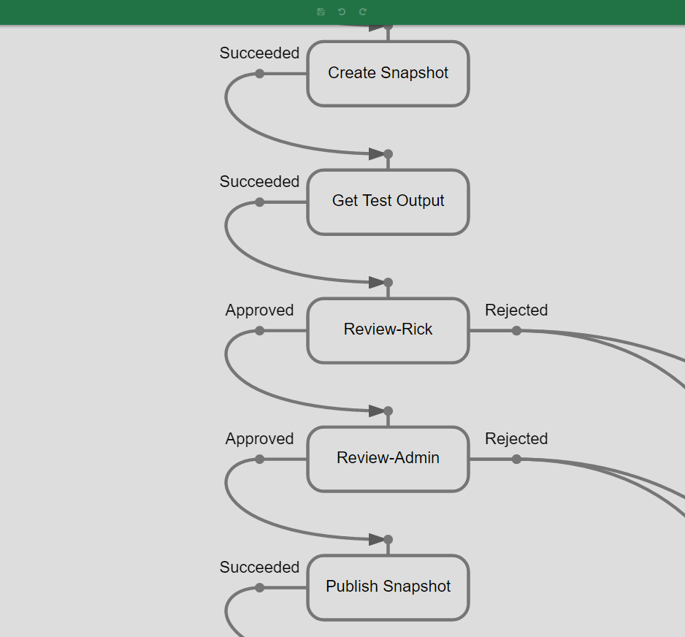
Governance: Stakeholder Oversight

Slide 42
Customer Centric: Identity within CCM
Notes:
In the past, enterprise data provided all the dynamic information necessary to compose documents. Names, addresses, and even preferences came from these external data stores. But there is a significant limitation to that. As Craig said, that outbound channel includes CCM and hosted digital documents, and these are not only consumers of information, but also sources of information. When we organize these around customer identity, we empower the marketing cloud with better analytical information, and the inbound side with customer-specific archives.
The first application of this is in the realm of customer preferences. As an organization begins to create options and autonomy towards the customer, those subscriptions, contact rules, and the like need to be managed. This is a logical extension of the CCM solution – so the addition of a newsletter, for example, doesn’t require new fields to be integrated into the ERP system. Local customer identity provides this opportunity to isolate and manage preferences right within the platform that generates the documents.
This customer identity with the CCM platform enables easy click-through to specific customer records, and access to all documents sent to the customer. This even extends to customer portal access… with credentials, the customer can get direct access to their documents, and even to self-administration forms.
The last customer identity feature I want to talk about is analytics. Customer engagement is the goal of this age of the customer, and progress toward that means measurement. It means tracking the response to outbound documents, so incremental improvements can be made over time. It means learning more and more about each of your customers.

