Slide 1
MAKE EVERY DOCUMENT COUNT
Notes:
This presentation is intended to
Introduce Ecrion as a partner/software vendor
Introduce the relationship
Introduce the EOS product – overview

Slide 2
Who is Ecrion?
The Mission:
Help companies around the world more effectively
communicate and engage with their customers.
The Strategy:
Apply Customer Communication Management
software, technology, training and services
The Flagship Product:
Ecrion Omni System (EOS)
Notes:
We have been involved in document production for 15 years, providing document authoring and document composition products and services.
CCM is an evolution of document production, to take into account new channels, new technology, and new organizational requirements. CCM is the foundation for us to fulfill our mission within the Age of the Customer.
Our flagship product is Ecrion Omni System, which has captured our companies expertise in the customer/company relationship

Slide 3
Ecrion Corporate Profile
Founded 2002
Headquartered Rockville, MD USA
Select Global Partners
Customers on 6 Continents
Primary Industries
Insurance, Banking, Finance, Gov’t, Telco, Travel, Retail, Healthcare

Slide 4
Modern Document Production Is…
Ecrion Omni System
Document Production
Customer Engagement Management
Governance
Digital Experience
Customer Communications Mgmt.
Customer Intelligence
Authoring and Composition
Template Lifecycle Management
Notes:
Welcome to this brief explanation of Ecrion’s Omni System.
My goal is to provide you with a clear understanding of the sorts of business challenges this solution can address, and a general understanding of how our solution is applied. There are too many interlinked topics surrounding “Document Production” that are not intuitive, such as “customer communication management”, “governance” and “template management”. This solution most certainly does document production in the traditional sense, but it does so much more. These added components are not optional, but have been ushered in by the switch to digital delivery channels, and the additional weight put on engaging and timely customer communication.
We will explore modern document production during this brief introduction.

Slide 5
Document Delivery Goes Beyond Paper
Mail
Mobile
Electronic
Notes:
Let’s start by looking at this from your customer’s perspective. But what customer? That’s the key question. Each customer may have different delivery preferences for the exact same communication. Some will be young digital natives, and some will be retirees. To maintain customer satisfaction, and to maximize customer retention, your document production solution has to personalize delivery channels.
Let’s get more specific about delivery. Sometimes, these documents you need to produce are immediately provided to an integrated application, like a web server, so that customers visiting your web site have access to their communications. Other times, the documents are tagged and stored for later search and retrieval, perhaps with a URL to allow direct internet retrieval, or smart phone access. Most often, though, the document needs to be sent through a channel: to a print queue, an Email server, an SMS service, or even a content management system, such as Microsoft’s SharePoint.
Our solution includes outbound document delivery, and provides management and oversight of the delivery process, on a customer-by-customer basis.
The key is to be in communication with your customer on their channel of preference, with the right level of security. The EOS solution delivers this.

Slide 6
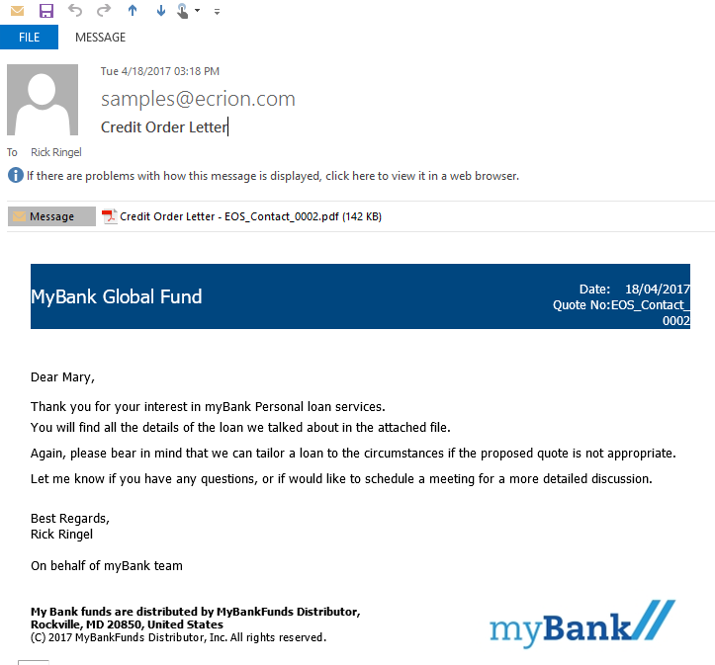
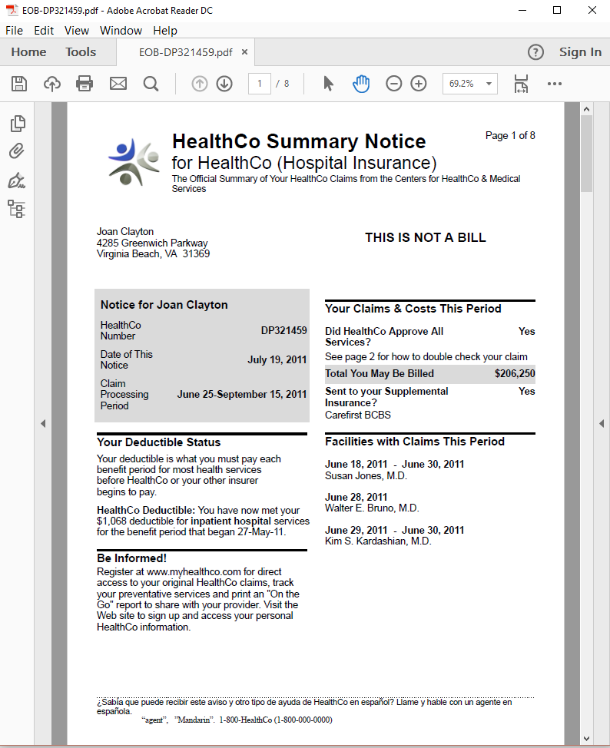
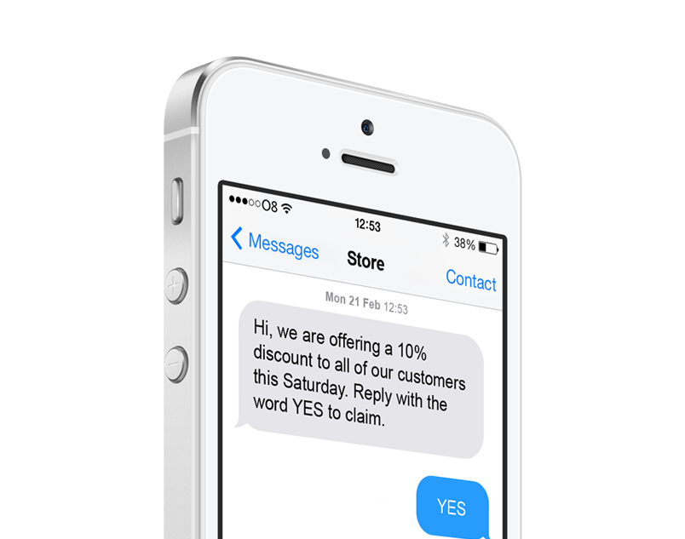
Document Production Goes Beyond Print
Notes:
The document’s format is selected according to the delivery channel. As I explained in the previous slide, customer-specific data can be used to direct delivery over the preferred channel.
Our solution produces documents in output formats specific to the selected channel, on a customer-by-customer basis. Email attachments are traditionally PDF, but Email bodies are HTML. Print streams might be AFP, but mobile phone delivery requires HTML5 and responsive documents. Modern document production requires flexibility in output formats, while supporting efficient authoring and maintenance of the document templates.
In our solution, the templates that come out of the authoring step are channel-agnostic, and it is only during composition that choices such as PDF or HTML are made. That means you only build one document template, and you can deliver it over any channel. This solution assures the right format is rendered for the selected channel.
The importance of this cannot be overlooked. Previous investments you have made in authoring documents can be leveraged to support new delivery channels, incrementally, according to your business needs. Subdocuments, which are reusable components, can be reused across channels. This improves ROI by lowering your maintenance and development costs, and it helps you govern the process by keeping redundancy out of your template library.

Slide 7
What Was Document Production Is Now Customer Communication Management
Flexible
Agile
Governed
Coupled with Business Process
But through Delegation
Deploy on-prem or in the cloud
Notes:
When we consider that customer preferences, different channels, and different content all have to come together, then our traditional definition of document production isn’t satisfactory any more.
These complexities need to be addressed, just as the EOS solution has done.
Flexibility is necessary in order to support innovative customer-centric business strategies. Channel preference is just the beginning. Dynamic content and targeted messaging are also new requirements that fall into the “flexibility” category.
Agility is necessary in order to eliminate customer communication project backlogs. Agility means your inspiration for a new document or an updated document can become a reality with no delays. It means automation within the design and test processes, as well as automation within the production processes.
Governance is necessary in order to keep order, assure quality, and secure personal information. A company’s brand has never been more exposed, as the number of documents and the number of changes to these documents is increasing as customer-centric strategies take root. Governance assures that stakeholders participate through policy and key interactions, without dragging these busy people into day-to-day operations.
Customer Communications Management is the new document production.
Document production has always been coupled with business process, but the nature of that relationship has changed. Business processes deal with services, finances, tracking, shipping, billing, and the like. But, with the EOS solution, those automated business processes no longer embed any document production logic. Instead, document production is delegated, and the EOS solution, the manager of your customer communications, deal with all the variations that serve your customer base. Targeting and personalization, document content and brand policy, all are now centralized in the CCM layer, which free your automated business processes from constant change as the flexibility and agility are put to work.

Slide 8
Document Authoring & Document Composition
Two Phases, One Unified Movement
Authoring – Document Design and Layout
Encourage Template Reuse
Orchestrate Digital Asset Assembly
Achieve Customer-by-Customer Variation
Engage with Customer
Efficiently Design Across Team
Composition – Data gathering, Rendering and Delivery
Automate and Integrate
Attain High Capacity and Low Latency
Remain Scalable
Oversee and Administer
Store, Search, and Deliver
Remain Flexible
Notes:
The EOS solution provides the authoring environment, and it provides the composition environment. But with this solution, the two flow together seamlessly. At the center of this is the digital asset repository. The Authoring step places images, templates, business rules, and other supporting files into the repository, while the Composition step draws from the repository. Governance features oversee the progression of digital assets from the author’s initial draft all the way into the secured production environment. Two phases, but one graceful flow.
(Talk through the bullet items, underscoring value, rather than features, according to interest level of audience. Careful not to get bogged down in detail)
Authoring
Template reused means lower costs and less time (agility).
Digital Asset assembly means governance over things like images, styles, headers, footers, brand, all within assets shared across multiple document projects. (agility)
One template with variation (flexibility) is more cost effective, and easy to incrementally improve (agility)
Engaging content, like interactive documents and targeted content improve customer satisfaction.
Teamwork is essential to end backlogs – specific tools for specific skill sets, working in concert in a shared workspace.
Composition
Integrate with your data sources, integrate with your business processes. Reduce risk of manual steps, improve efficiency through automation, and isolate customer communication management from your business processes.
Never be bottlenecked – solution supports high capacity batch, and low-latency on-demand,
Capacity increases are simple hardware additions (load balancing over servers)
Oversee through previews, job history, advanced search, dashboards, audit trails, version history, etc.
Provide universal access. Solution stores all documents for later retrieval through APIs, URLs, GUIS, search, etc. Also delivers documents to printers, Email servers, content management services, etc. Reach your customers on the channels they prefer.
One customer communication infrastructure to serve periodic, on-demand, and correspondence needs.

Slide 9
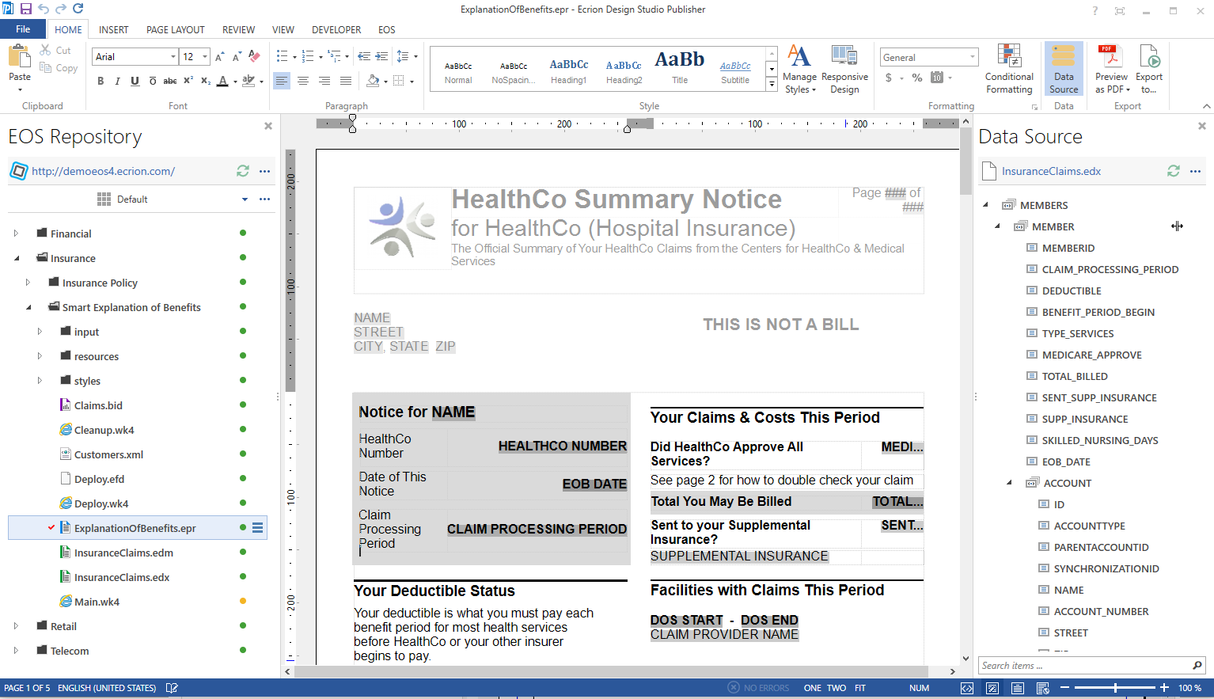
Document Authoring: Templates
Ecrion Design Studio: Publisher
Easy to Use
WSIWIG
Design Surface
EOS
Integration
Drag & Drop Dynamic Data
Notes:
Solution Specifics – Tool benefits for Publisher
Just talk through, being only as detailed as audience needs.
Key Values:
Easy for business users to use this
Easy access to data fields
Governance and teamwork through integrated connection with document repository

Slide 10
Document Authoring: Templates
Ecrion Design Studio: Data Modeler
Graphic Extract- Transform- Load
Uniform Data Output
EOS
Integration
Diverse Data Sources and Formats
Filter, Join, Normalize
Notes:
More document authoring tools
Data Modeler
Key Values:
Maximize teamwork: Let your IT people own the data access, and put document layout and content on business users
Agility & Reuse: Data models can be reused in multiple projects
Remain flexible! Absorb changes in storage architecture without impacting templates

Slide 11
Document Authoring: Templates
Ecrion Design Studio: Architect
Data Visualization Toolbox
Uniform Data Input
EOS
Integration
Maps, Charts, Tables, etc.
Embedded Data Operations
Notes:
Another authoring tool
Main Values:
- Engage with Advanced data visualization and even interactive graphs and charts
Teamwork again: data visualization expert provides drag-and-drop widgets to team doing layout of documents.
Reuse across projects
Data is prepared by Data Model, with all those benefits passing to data visualization tool too.

Slide 12
Summary: Ecrion Design Studio’s Benefits
Ease of Use
Extend Team of Collaborators
Skill-Specific Tools
Empower Specialists to Contribute
Integrated Collaboration Workspace
Empower Teamwork
Enterprise Data Model
Retain flexibility
Interactive Documents
Engage with Customers
Channel Agnostic Templates & Assets
One Template serves all channels
EDS Authoring Solution
Notes:
Summarize from previous steps, again underscoring value.
This is more of a feature->value map.
The solution delivers [] and your benefit is []

Slide 13
Document Composition: Integration
Notes:
After a template has been authored, it then has to be integrated into your business process. This is a critical part of the solution.
The composition step should be isolated from the higher-level business processes. They should never need to deal with communication details, such as delivery channel. On the other hand, the higher-level business process is in charge, and needs to delegate document production in a variety of different situations, with a variety of different triggers.
The EOS server sits between your business processes, databases and applications, and the output of our authoring tools. On the business side, the server integrates with your business process in real time through different types of triggers, APIs and data acquisition protocols and products. On the authoring side, it pulls in all the templates, digital assets, and data necessary to render the perfect document to support the business situation.
This is all orchestrated, one production process, gracefully executed from end to end.
The EOS solution excels at this integration, both in terms of data integration, and in terms of process integration. Web site pages are built using an On-Demand interface that returns documents immediately to the client. Periodic documents run in batch, with capacity to produce millions of documents in a day. Correspondence is built interactively, validating input and placing a layer of control over content and layout of standard and ad-hoc communications.

Slide 14
Document Composition: Workflows
Connects to Business Process
Document Production Rules Independent
Connects to Collaboration Projects
No external digital asset management
Ease of Use
Programmers Unnecessary
Conditional Paths for Each Customer
Personalize, execute preferences
Omni-Channel Distribution
Print, Email, SMS, Web, etc.
Notes:
Workflows orchestrate the production of every document.
Flexibility is achieved through these workflows
Many different ways to trigger execution
Many different ways to get data into the workflow
Data-driven paths through the workflow
The key value is in the ease of use, and the flexibility it provides.
Add new paths incrementally
Use customer preferences to drive workflow steps
Deliver documents and document content back into business process (especially correspondence)

Slide 15
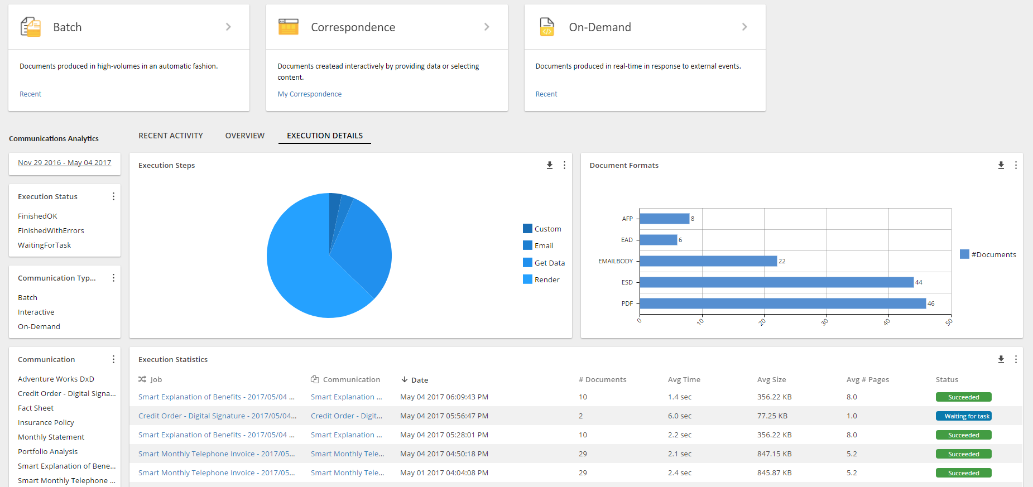
Document Composition: Administration
Production Automation
Event triggers, time triggers, etc.
Dashboards
Investigate Operational Status
Production History
Support Audits, Search
Security Management
Personal Info, Production Environment
Environment Configuration
Isolate Develop, Test, Production, etc.
Notes:
So far we have talked about the authoring and composition aspects of our product. But, in addition, all of this needs to be managed.
Management as a topic can take quite some time to walk through, so I won’t hit you with much detail. I will mention though, that this is one of our favorite topics on our blog, and I encourage you to take a look.
Automation is set up through the admin interface. GUIs offer configuration options for triggers, public URLs, schedules.
Dashboards offer visual representation of the health of the system, and the server’s progress and throughput.
Sometimes audit is essential, especially when a third party is investigating conformance. Audit trails are built into the EOS solution, along with advanced search features.
Security management is essential. We can never lose site of the personal nature of much of the data that goes into these document composition processes. Our solution offers security frameworks that support your policies, be it a central identity management system, or encryption of data.
Keep staff partitioned according to their role – developers not able to see production system files, and strict policy enforcement when moving projects from one environment to another.

Slide 16
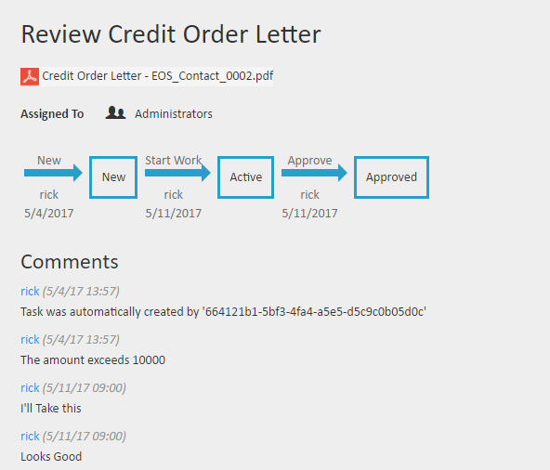
Document Composition: Governance
Review Outbound Docs Before Delivery
Assure Quality, Accountability
Review As Projects Proceed to Production
Support Stakeholder Participation
Shared Digital Assets
Manage Branding
Security Management
Limit Access to Workspaces, Documents
Repository Version Control
Track changes, roll back option
Metadata and Advanced Search
Find Every asset and rendered document
Notes:
Governance is about two things: assuring policy is enforced, and about giving stakeholders accountability over the policies they are interested in.
Review and Approval is part of the workflow’s orchestration process.
Conditions based on business rules can trigger a review prior to delivery (e.g. customer service rep is still in training).
Invite stakeholders to review and approve project and project output prior to promoting into the production environment. Accountability and approval history is captured and available.
Distribute digital asset responsibilities: branding to marketing (style sheets, images, etc), terms and conditions to legal, messaging to sales.
Use permissions to assure limited access appropriate to each team member.
Know what has changed and why, and always be able to role changes back out.
Never spend time looking for a document or an asset – use search rather than try to navigate through multiple levels of file structures (like Google and the Internet)
Project test methodologies, as well as version control, and a built-in review and approval framework, provide a managed path from development all the way to your production systems.
It includes composition-time choices of which templates to use for a given business process. All of this taken together constitutes “template lifecycle management”, and is built into our solution.
Management also means that stakeholders, who are not part of the day-to-day operations of the system, have controls in place that assure their policies are followed. Is the right logo used on every document? Is the standard contact information consistent and up to date? Our solution offers these sorts of controls. The general term we use for this is governance.

Slide 17
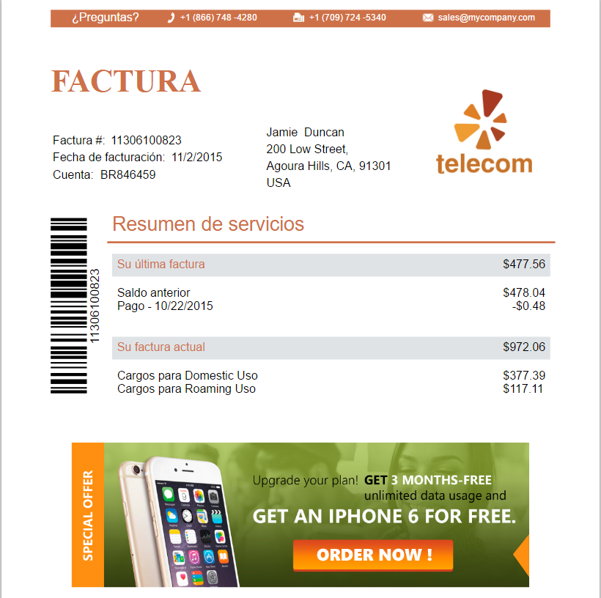
Document Composition: Personalization
Target Content to Customer Segments
Improve engagement, satisfaction, loyalty
Integrated Preference Management
Flexible, Easy Expansion of preferences
Customer self-administration
Save time and money
Overlay Messaging
Add/change messages without risk
Notes:
During composition, dynamic data is not only placed into the document, but it can also drive conditional content.
Let’s say you have two different marketing images, one for prime customers, and another for lower priority customers. Our solution makes it easy to use a single template to render this one way or another, according to the customer’s profile. That is just one example of how to use our tool to –target- customers without the burden of authoring countless templates.
Targeting is not quite customer-specific, though. Targeting is based on segmentation of your customers. The solution also provides for personalization. This may be as broad as selecting languages as is shown here in the slide, or as specific as customizing the look of a monthly invoice to include either tables or pie charts, according to their preference.
Customer preference management is built into our solution. Offer self-administration to save money, and keep all preferences isolated within the solution to remain flexible and agile. Avoid programming preference fields into other applications that don’t even use them.
Overlay messaging on top of tested production documents. Manage messages to specific customer segments, and get metrics showing engagement. Build up your ability to engage through this feedback.
The overall goal here is to maximize the value of the customer experience. Our solution provides the tools necessary to accomplish this on a customer-by-customer basis.

Slide 18
Conclusion
Document Production is Part of a Bigger Whole
Flexibility, agility, and governance
Keep your quality up
Keep your costs down
Keep Customer Satisfaction up
Remove Document project backlogs
Notes:
Adapt to your customer as needed. What was it that was most important to them?

Slide 19
Q & A

Slide 20
THANK YOU

